Slide 1
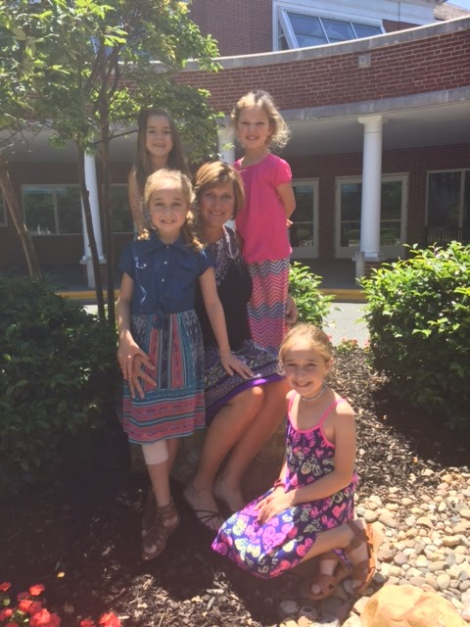
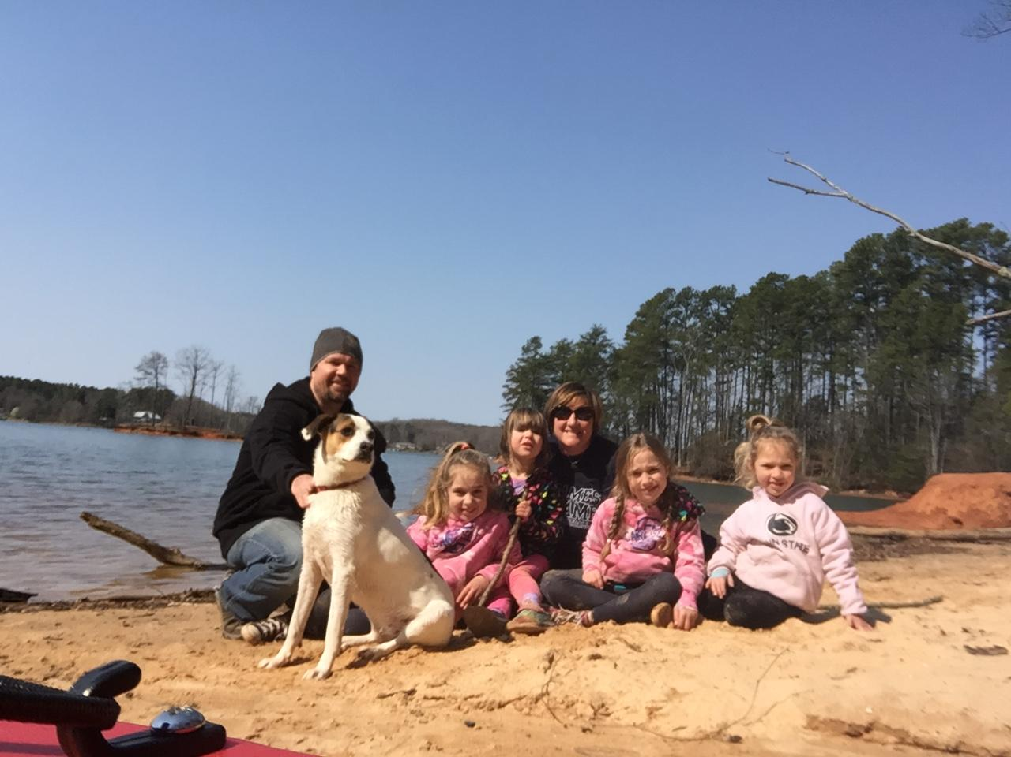
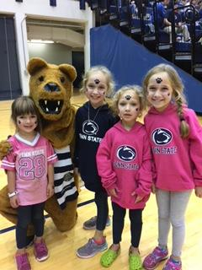
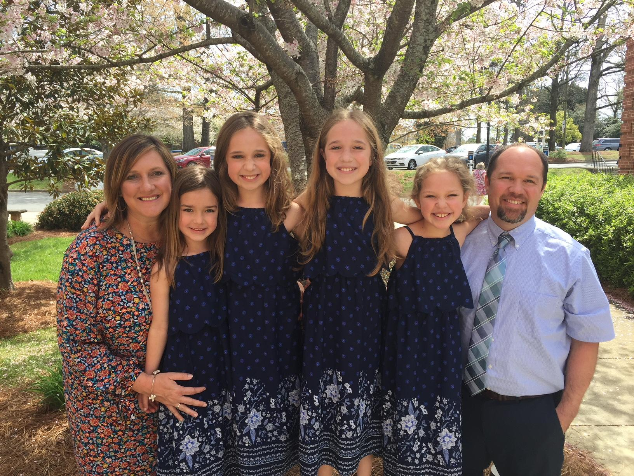
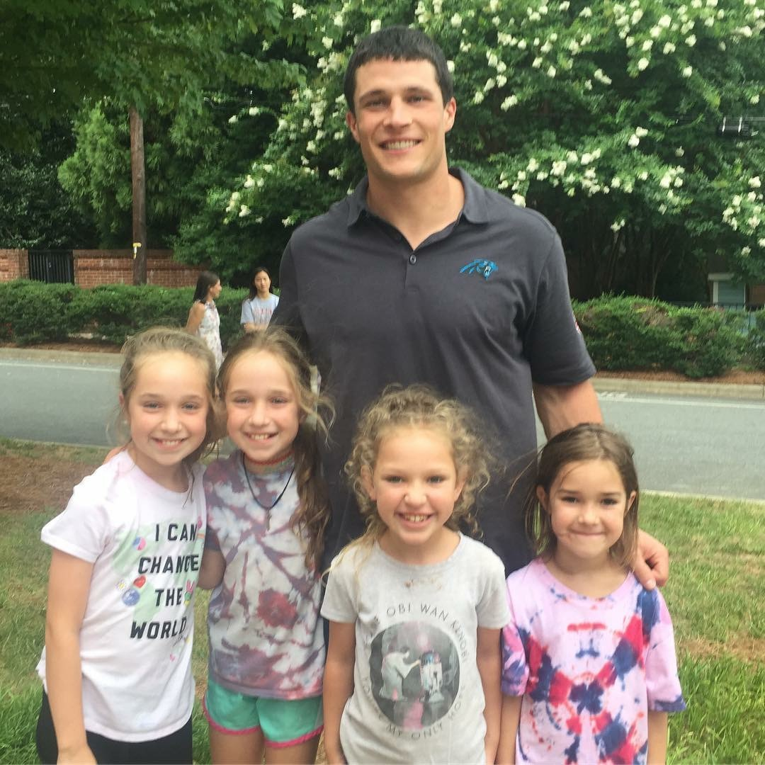
A Little Bit about Mrs. Mateer
~ Originally from York, Pennsylvania
~ Graduated from University of North Carolina - Greensboro - Human Development & Family Studies - Elementary Education
~ Began my teaching career in Martinsville, Virginia in a Title 1 School - taught Kindergarten, 2nd grade and preschool
~ Took 10 years away from the classroom to stay home with my girls and start our family
~ Starting my 9th year of teaching this year - and returning to Kindergarten after teaching 3rd grade last year at Selwyn
~ Have 4 girls at Selwyn - Mackenzie & Kylie - 5th, Madelyn - 3rd & Katelyn - 1st, Brian (my husband) and a spunky rescue dog - Lydia
~ Avid sports fan Go Panthers, Orioles, Capitals and Penn State!!
~ Love the beach, mountains, camping, traveling, spending time with my family!
~ So excited to be back at Selwyn and with your child this school year!!

Slide 2
Curriculum Night
September 27th
6:55 – 7:15
7:25 – 7:45

Slide 3
Mrs. Kellam, Mrs. Boughman, Ms. Demmitt, Mrs. Headd, Mrs. Abbate & Ms. Kivuti

Slide 4
Morning Meeting
Reader’s Workshop
Math Workshop
Writer’s Workshop
Science & Social Studies

Slide 5
Book in a Bag
Leveled Readers will be sent home Monday to Thursday - please log reading on yellow ledger and return the book the next day.

Slide 6
Assessments
KEA - Kindergarten Entry Assessment - BOY & MOY
MAPS - Reading & Math
Reading 3 D (mClass)
BOY, MOY & EOY

Slide 7
Grades are not given to Kindergartners - They are assessed on the following scale
4 -Exemplary
3 - Mastery
2 - Progressing
1 - Developing

Slide 8
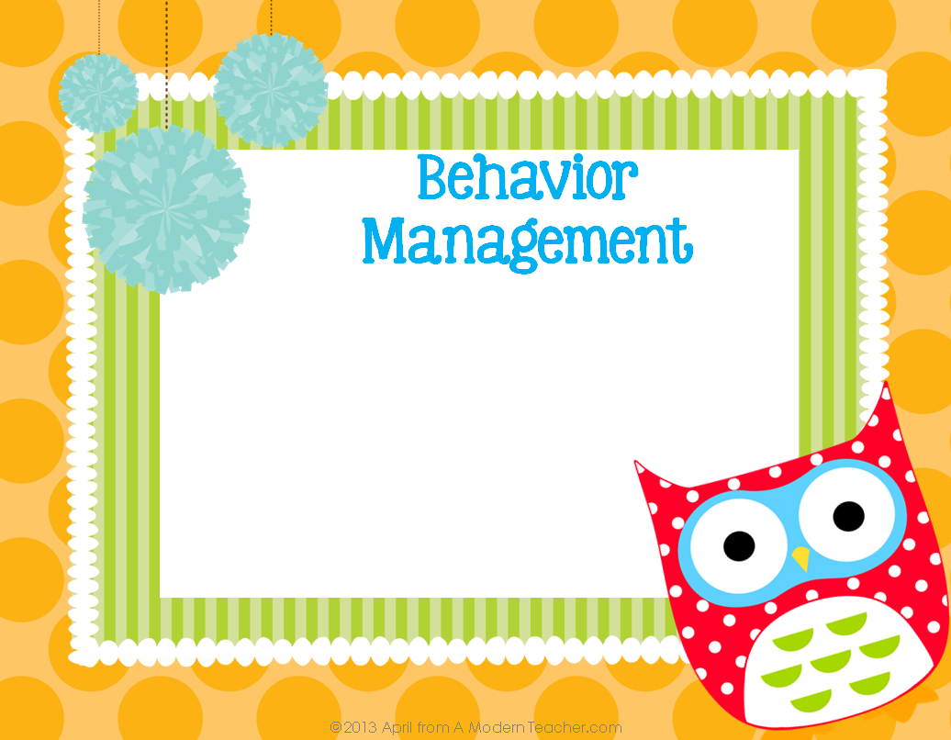
I am a firm believer in building classroom community, relationships and a positive discipline philosophy.
Proactive Redirection or “Calm-Down” Opportunities are given as needed. No news is Good News!!

Slide 9
7:15 - 8:00 Arrival
8 - 8:30 Morning Meeting
8:30 - 9:10 Learning Labs
9:10 - 9:20 Snack
9:20 - 10:00 Reader’s Workshop
10 - 10:40 Specials
10:45 - 11:30 Math Workshop
11:30 - 12:00 Word Work/Handwriting
12:05 - 12:35 Lunch
12:40 - 12:55 Interactive Read Aloud
12:55 - 1:30 Science/Social Studies/Health
1:30 - 2:00 Centers/Finish Up/Pack Up
2:00 - 2:30 Recess
2:35 - 2:40 Daily Wrap - Up
2:45 Dismissal

Slide 10
Monday - Technology
Tuesday - Music - Pasour
Wednesday - Music - Mitchell-Harris & Art - Swing
(Double Specials - TeamPlanning - 10:00 - 11:25)
Thursday - PE - Peterson
Friday - Media

Slide 11
Blue Selwyn Folder - will come home everyday with any papers and PTA/Office Correspondences - Please check daily and return the next day!

Slide 12
~ Honest & Open
~ Weekly Newsletter - Hoots & Hollers
~ Check Website
~ Phone Calls, notes home when needed
~ Parent/Teacher Conferences - October 22nd - November 9th
~Our classroom is an OPEN DOOR!!

Slide 13
Other Reminders
~ Snack
~ School Attendance
~ Transportation
~ Money
~ Birthdays
~ Extra Clothes
~ Show & Tell
~ Spot’s Sound Challenge

Slide 14
Children’s Theatre
Lazy 5
Farm
Recycling Center
**Room Parents will be reaching out for field trip volunteers!!

Slide 15
Room Moms
Jennifer Bailey - Emma’s Mom
Krista Bokhari - Chase’s Mom
**You must be a CMS registered volunteer BEFORE volunteering at Selwyn or CMS**

Slide 16
Amy Mateer
amyr.mateer@cms.k12.nc.us
Website
mateerkindergarten.weebly.com

Slide 17
Questions
& Comments
~ Room Mom Moment
~Questions
Thanks for coming
tonight!

